Slide 1
Student Record Manager System
EE599 Project – Spring 2020
-Krishna Sai Tarun

Slide 2
Basic characteristics:
-> This is going to be an interface for the instructor. It is for the instructor to maintain student records.
-> The interface will have options for the instructor to enter his/her details, enter the courses they are teaching. They can create an assessment and a student database and enter the students’ grades and marks for each assessment.
-> Can add/ remove students from the list whenever required.
-> Can calculate class averages, and give out grades.

Slide 3
Program flow and classes
Main(){
Here we call the student record manager object to start the process...
}
Class Student Record Manager {
Creates an instructor object who can perform further actions..
}

Slide 4
Class Instructor{
Vector of Courses he/she is in charge of{ course 1, course 2......}
}
Class Course {
All the details of the course (basics like ID and Name)—
map to assignments: {Assignment ID → pointer to Assignment Object}
map to students: {Student ID → pointer to Student Object}
}

Slide 5
Class assignment{
Every assignment object has a student list and their scores.
map {student ID → Score in the Assignment}
It has other details for calculating the weighted averages as well.
}
Class Student{
Every Student has a map to the assignments and has a record of scores for each assignment.
map {Assignment ID → pointer to Assignment Object}
map {Assignment ID → {Score in the Assignment, max Credit}}
}

Slide 6


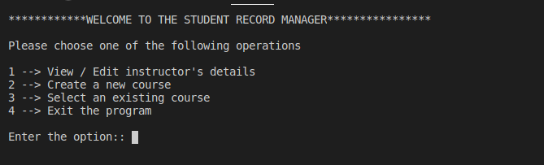
Initial interface!!!

Slide 7
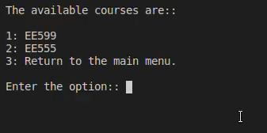
Created courses.

Slide 8
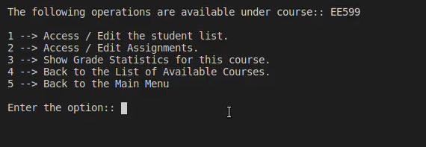
Inside a course

Slide 9
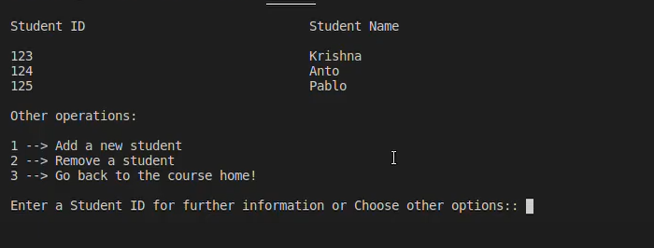
Student List

Slide 10
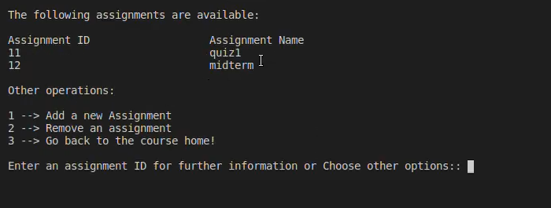
Assignment List

Slide 11
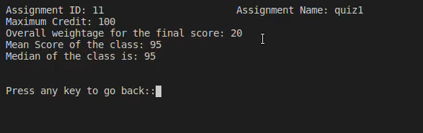
Inside an Assignment

Slide 12
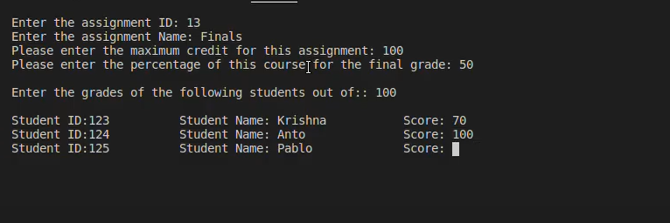
New assignment and enter scores

Slide 13
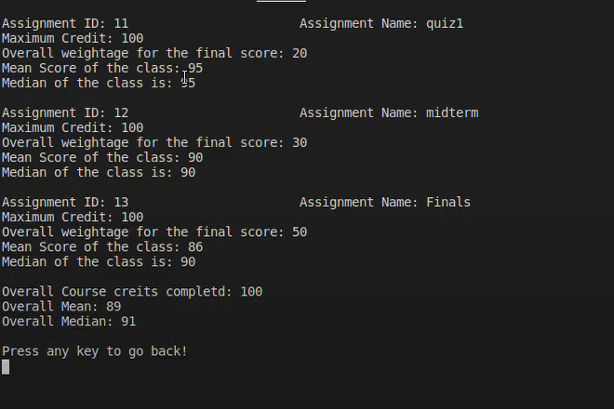
Course Stats

Slide 14
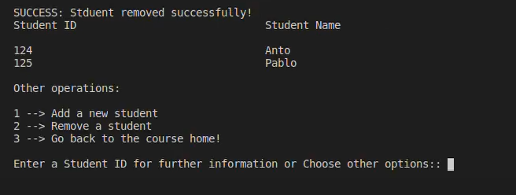
Deleting a student.

Slide 15
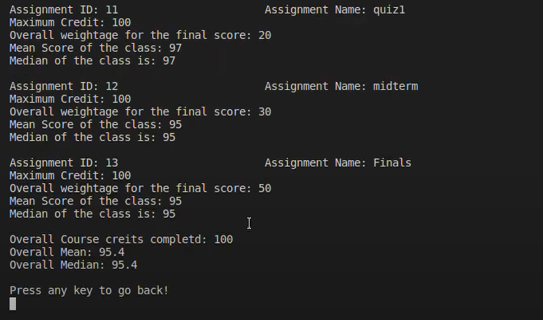
Updates stats

Slide 16
Other operations include:
Edit student scores by going into a student from the student list.
Delete an assignment and see the change in course stats.
Add a new student to the course and update all the assignments.

